Slide 1

Quiztopia
Team 06:
Rusho Bin Nabi, Matthew Niemczyk, Danny Peck, Danica Porter, & Menachem Rubin

Slide 2

User Personas
Student - Rusho
Teacher - Mendel
Independent Learner - Danica
IT - Matthew

Slide 3
Student User Stories
As a student, I want to be able to see what cards the teacher created for me, so I know what to study for.
As a student, I want to be able to view my classes so that I can see what classes I'm in.
As a student, I want to be able to see class sets so that I can see what the teacher wants me to practice and work on.
As a student, I want to be able to see how much I have practiced so that I can effectively study.

Slide 4
Teacher User Stories
As a teacher I would like to create new accounts for students so that when a student does not have an account yet, I can create an account for them so they can see the required material.
As a teacher I would like to list all classes so that I can delete, modify, add, and more generally manage all my classes.
As a teacher, I want to add students to classes so they can view required content.
As a teacher I would like to remove students so that if I incorrectly add a student to the wrong class, I can remove them.
As a teacher I would like to set a date by which all students in a class must view a set of flashcards in any form (quiz ...) so that students can review material before a test(?)
As a teacher, I would like to add sets of flashcards to a class, so that students can view the required content.
As a teacher, I would like to list the students to view the students' progress in a class.

Slide 5
Independent Learner User Stories
As an independent learner, I would like to create a new topic by entering a series of words and definitions and saving it as the name of the topic
As an independent learner, I would like to search for publicly available sets on a given topic
As an independent learner, I would like to use flashcards to improve memorization
As an independent learner, I would like to practice matching definitions to words
As an independent learner, I would like to be able to track my progress on a given topic
As an independent learner, I would like to be given feedback on the material that needs the most improvement

Slide 6
IT User Stories
User feedback sources
A help section
Access to server logs
Notify users of shutdown and changes to the website
Temporary server shutdowns

Slide 7
Critical Requirements
Easy Maintanance - Matthew
Flashcard File System - Mendel
Memory exercises - Danica
Share sets – Danny :)
User authentication - Rusho

Slide 8
ID: | FlashCardFS
Title: | A system for managing sets of flashcards
Description: | This will allow user and especially teacher to group possibly common flashcards into folders.
Primary Actor: | General Users
Preconditions: | Successful login
Postconditions: | File System for flashcards is modified.
Main Success Scenario: | 1. User creates new folder, or selects an already created one. 2. They create a new flashcard set for the folder. 3. Or they select one of their other flashcard sets to be added. 4. The flashcard set is added to the folder.
Extensions: | 1. This can be extended to create a class or folder of flashcards shared by teacher to students. 2. User provides invalid input (bad folder name, or no flashcard set selected to add to folder) - Instruct user to provide proper name or select a proper set of flashcards.
Frequency of Use: | Depends on the user: Teachers will use it very frequently, but other users will use it much more infrequently.
Status: | Developing plan for code structure
Owner: | Mendel Rubin
Priority: | High
Flashcard File System

Slide 9
Memory Exercises
ID: | MemTesting
Title: | Engage in memory testing exercises
Description: | This describes the process of handling the user interactions as they participate in various memory exercises.
Primary Actor: | Independent Learner
Preconditions: | - Successful login - Topic created / Information entered
Postconditions: | - The user’s progress is updated - Improvement suggestions are created / updated
Main Success Scenario: | 1. User chooses which method they want to use to test their memory 2. System generates a new version of the chosen exercise 3. System keeps track of correctness as user completes the activity 4. User is given feedback based on their performance 5. System stores the user’s progress for the given topic
Extensions: | 1) System doesn’t recognize input - Instruct user to change their input User attempts to generate exercise using an empty set - Warn user that their current topic is an empty set
Frequency of Use: | Very often, almost every time website is used
Status: | Developing plan for code structure
Owner: | Danica Porter
Priority: | High

Slide 10
Shared Sets
ID: | SharedSets
Title: | Sharing and Sending Sets between Users
Description: | This will allow the different users to share the sets that they have created between one another.
Primary Actor: | General users
Preconditions: | - Successful login - Pre-created CardDeck(s) on one user's profile.
Postconditions: | - Dual access to CardDeck(s). - Owner controls visibility and editing settings.
Main Success Scenario: | User opens a CardDeck or a folder of CardDecks. They select that they want to share the Decks. They choose how they want to share the deck (shared memory, txt file, or link). The preferred deck format is sent to the other user.
Extensions: | Allow original Owner to control visibility and editors. Allow non-owners to create a copy of the Deck.
Frequency of Use: | Moderately frequent, approximately once every few user sessions.
Status: | Developing plan for code structure
Owner: | Danny Peck
Priority: | High

Slide 11
ID: ​ | Easy Back-end​ up work
Title:​ | A system for shutting down and working on backend
Description:​ | This will allow user to have easy access to the backend without interfering with users
Primary Actor:​ | IT Users
Preconditions:​ | Successful server shutdown
Postconditions:​ | Backend code is modified
Main ​ Success Scenario:​ | 1. User successfully shuts down server 2.​ User modifies backend code 3. Server is restarted at appointed time told to users
Extensions:​ | Be able to inform users about the time that the server will be shutdown and restarted
Frequency of Use:​ | Hopefully infrequently, but could have more use on initial launch
Status:​ | Developing plan for code structure​
Owner:​ | Matthew Niemczyk
Priority:​ | High​
Easy Back-end work

Slide 12
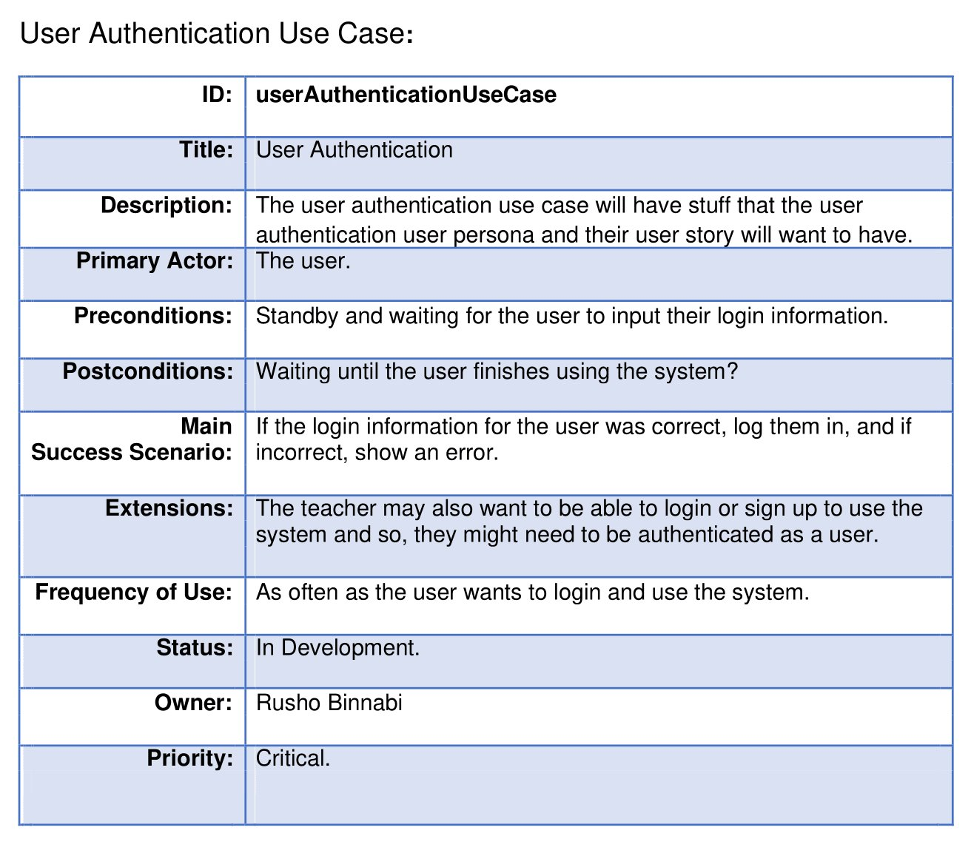
User Authentication

Slide 13
Non-Functional Requirements
Efficiency:
- High space efficiency to account for limited DB size.
- Medium time efficiency because operations are free on MongoDB.
- For the prototype, want to handle 250 users at a time.
Portability:
- Delivered as a web service. Want compatibility for Chrome, Firefox, and Safari.
- Support for mobile users will come later.
Privacy/security:
- Minimize user data storage
- Properly salt and hash passwords.

